Slide 1

SQL DATA ANALYSIS
AND
VISUALIZATION WITH POWER BI
FOR
USFDA

Slide 2
Project Objectives
Part - 1 SQL Queries:
Task 1: Identifying Approval Trends.
Task 2: Segmentation Analysis Based on Drug Marketing Status.
Task 3: Analysing Products.
Task 4: Exploring Therapeutic Classes and Approval Trends.
Part - 2 Power BI Visualizations:

Slide 3
Project Objectives
Part - 2 Power BI Visualizations

Slide 4
Project Objectives
Part - 2 Power BI Visualizations:
Visualize the yearly approval trends of drugs. Highlight any significant patterns and/or fluctuations, if any.
Explore approval trends over the years based on different sponsors. Uncover patterns and changes in approval rates among sponsors.
Visualize the segmentation of products based on Marketing Status.
Show the total number of applications for each Marketing Status. Enable users to filter by years and MarketingStatus for detailed analysis.
Analyze the grouping of drugs by dosage form. Visualize the distribution of approvals across different forms. Identify the most successful dosage form.
Visualize drug approvals based on therapeutic classes. Identify classes with the highest

Slide 5
Project Objectives
Part - 2 Power BI Visualizations:
Visualize the yearly approval trends of drugs. Highlight any significant patterns and/or fluctuations, if any.

Slide 6
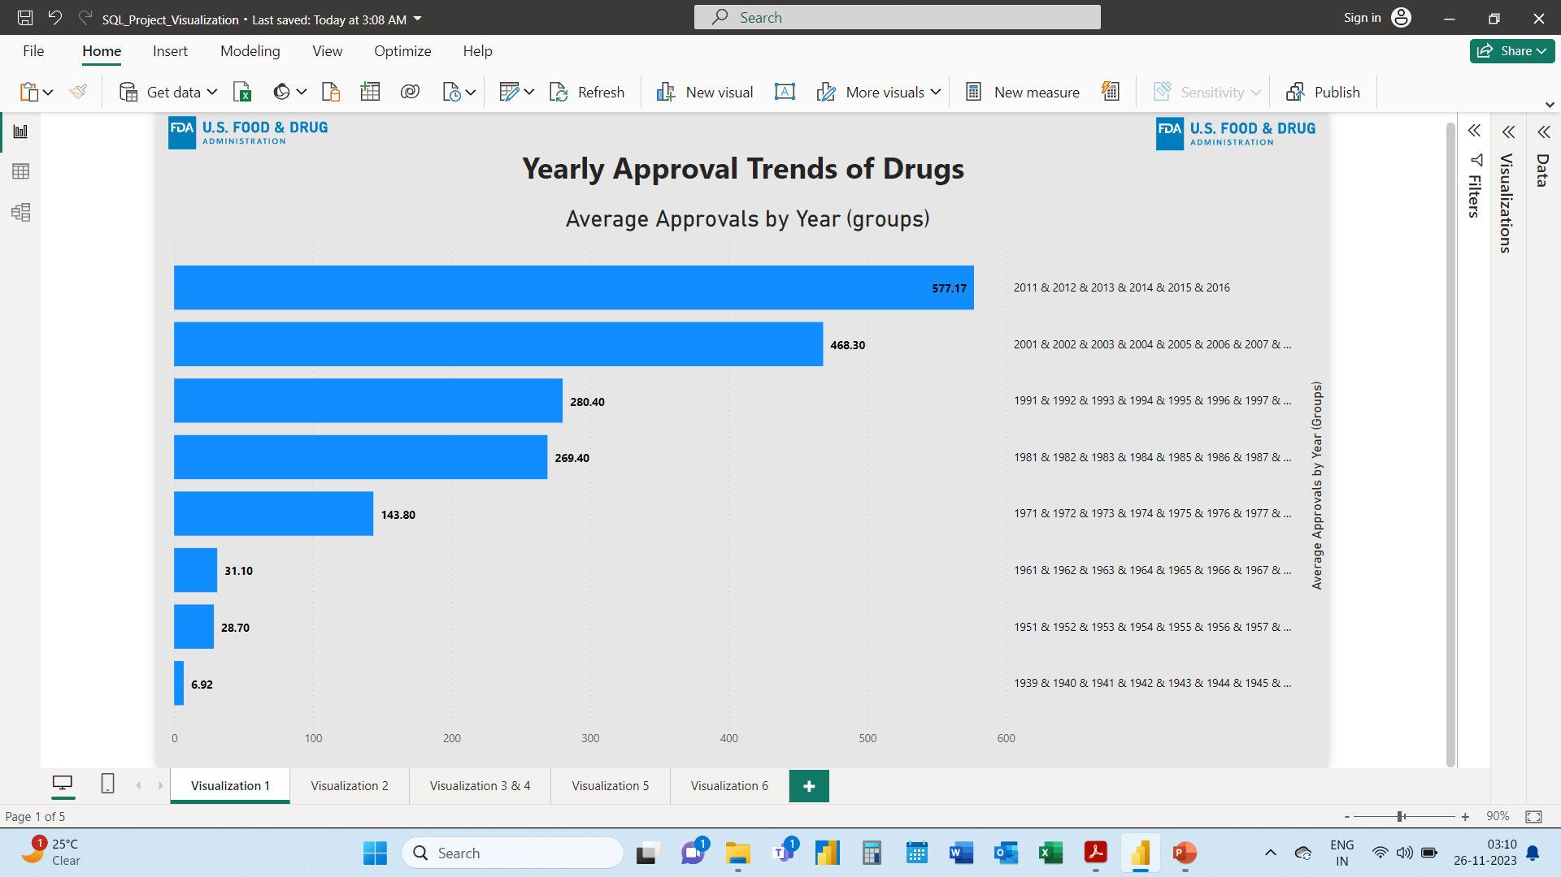
Project Objectives
Part - 2 Power BI Visualizations:
Visualize the yearly approval trends of drugs. Highlight any significant patterns and/or fluctuations, if any.
Highest Approval between 2011 to 2016.
This significant rise can be seen from the year 2000.
Approvals were least from 1939 to 1970
We can conclude that development in medical science in 1990’s gave rise to new drug development and approval

Slide 7
Project Objectives
Part - 2 Power BI Visualizations:
Explore approval trends over the years based on different sponsors. Uncover patterns and changes in approval rates among sponsors.

Slide 8
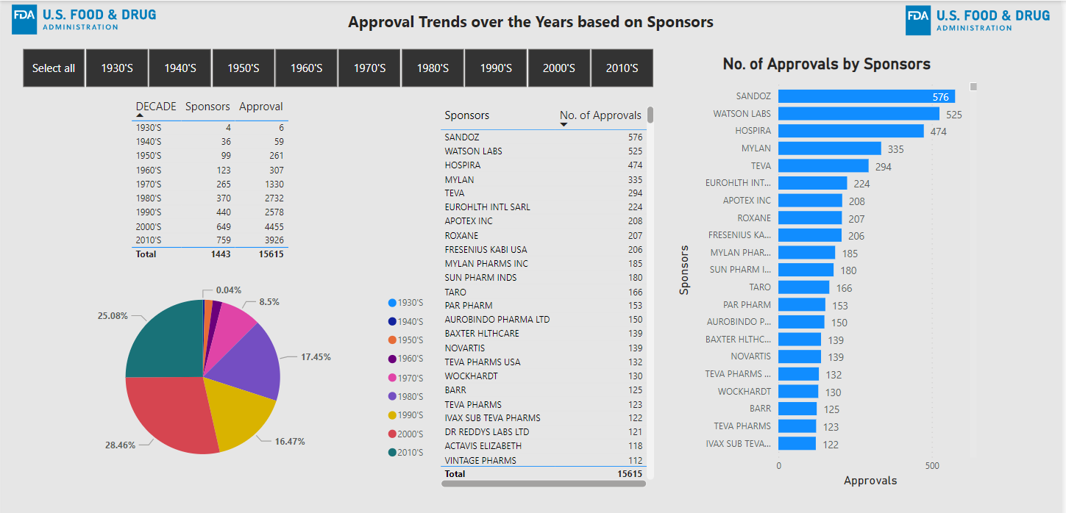
Project Objectives
Part - 2 Power BI Visualizations:
Explore approval trends over the years based on different sponsors. Uncover patterns and changes in approval rates among sponsors.
Sandoz has the highest number of approvals over the years. Followed by Watson Labs and Hospira.
Since the 1970’s it is seen that the sponsors are filing more applications for NDA and there by approvals per sponsor has increased drastically.

Slide 9
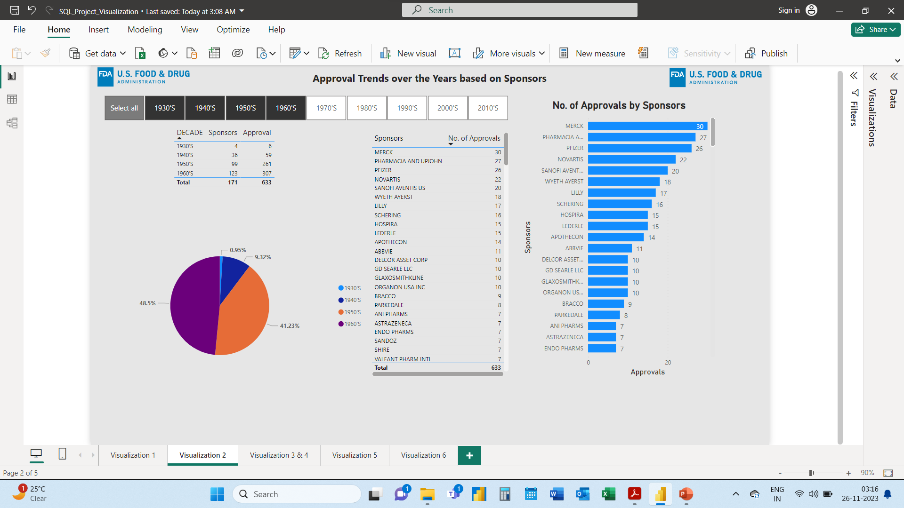
Project Objectives
Part - 2 Power BI Visualizations:
Explore approval trends over the years based on different sponsors. Uncover patterns and changes in approval rates among sponsors.
From 1939 to 1969 there have been only 633 approvals on applications by 171 sponsors.
MERCK is leading sponsor with highest number of approvals.

Slide 10
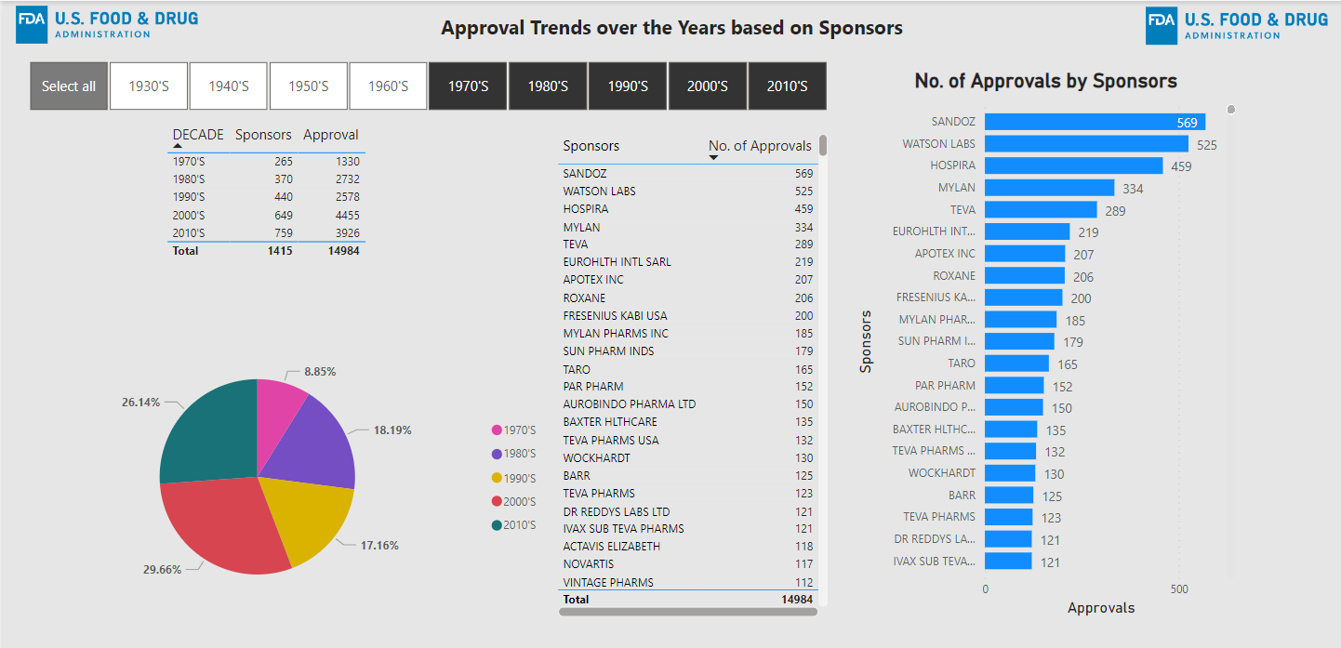
Project Objectives
Part - 2 Power BI Visualizations:
Explore approval trends over the years based on different sponsors. Uncover patterns and changes in approval rates among sponsors.
From 1970’s to 2010’s there has been almost 15K approvals from applications by 1415 sponsors.
Number of approvals per sponsor has also improved.

Slide 11
Project Objectives
Part - 2 Power BI Visualizations:
Visualize the segmentation of products based on Marketing Status.
Show the total number of applications for each Marketing Status. Enable users to filter by years and Marketing Status for detailed analysis.

Slide 12
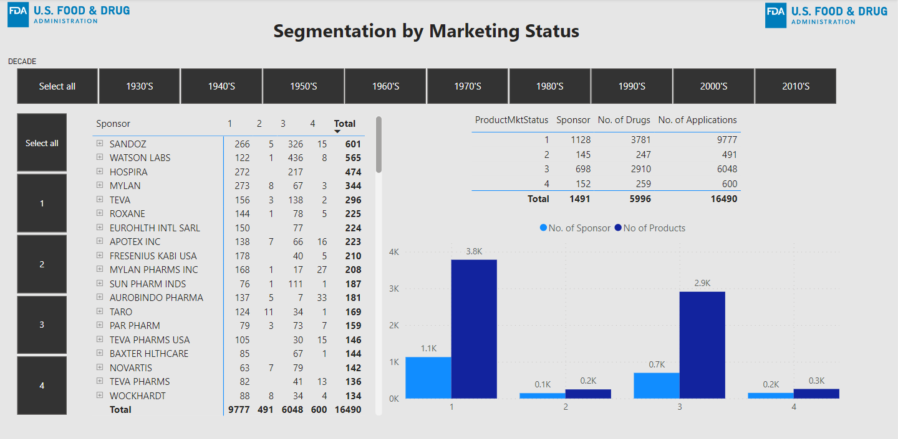
Project Objectives
Part - 2 Power BI Visualizations:
Visualize the segmentation of products based on Marketing Status.
Highest number of applications are in product market status 1 which comprises of total 3781 drugs.
Market status 3 has the second highest number of applications which comprises of 2910 drugs.

Slide 13
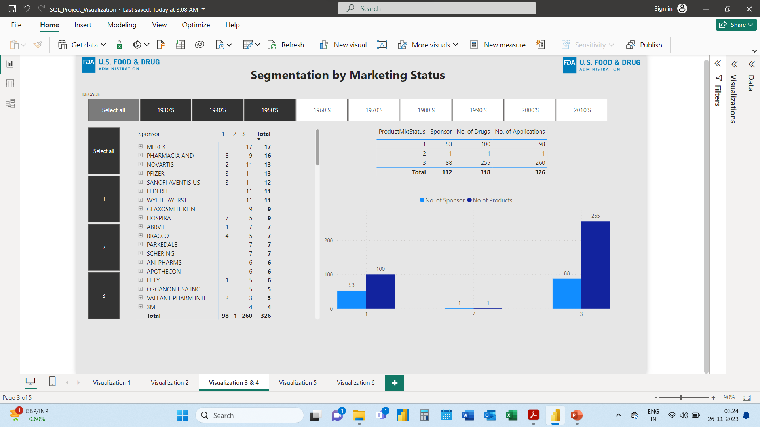
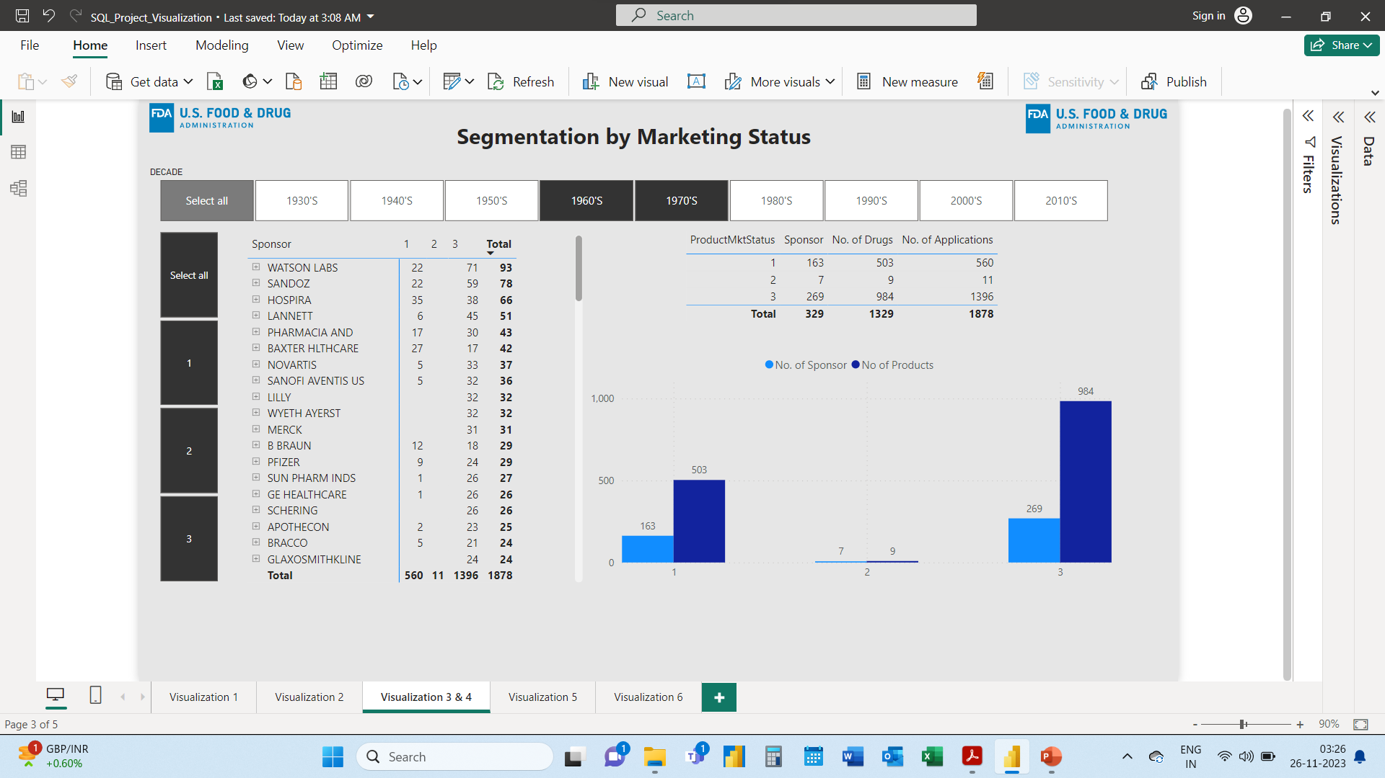
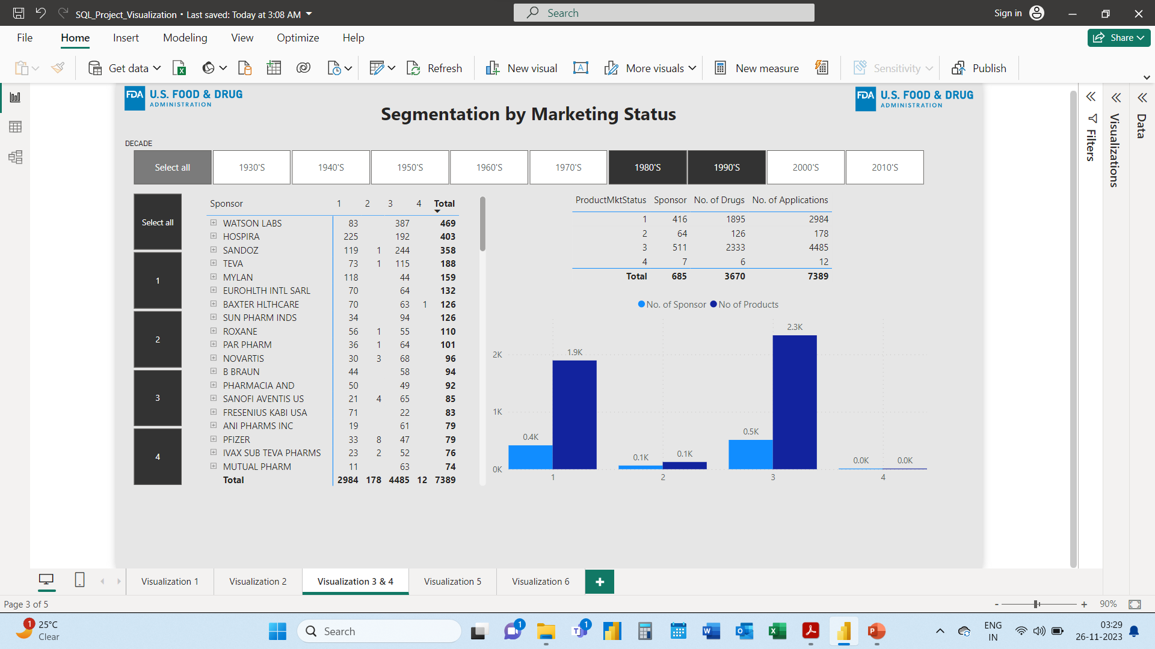
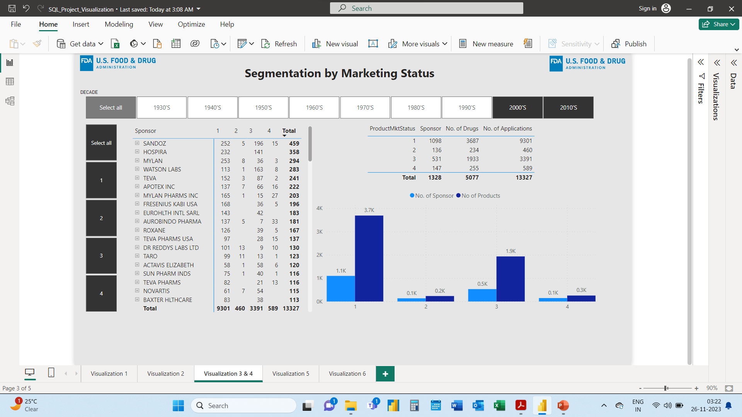
From 1930’s to 1979’s there where only 3 stages of product market status and majority of the products where in stage 3
From 1980’s to 2010’s there are 4 stages of product market status.
In 80’s & 90’s majority of the products are in stage 3
In 2000’s and 2010’s majority of the products are in stage 1

Slide 14
Project Objectives
Part - 2 Power BI Visualizations:
Analyze the grouping of drugs by dosage form. Visualize the distribution of approvals across different forms. Identify the most successful dosage form.

Slide 15
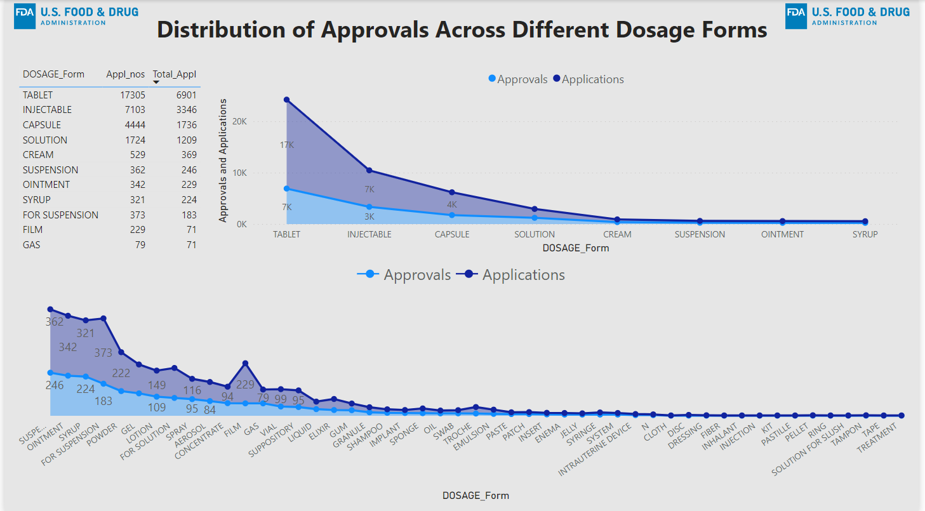
Part - 2 Power BI Visualizations:
Analyze the grouping of drugs by dosage form. Visualize the distribution of approvals across different forms. Identify the most successful dosage form.
Tablets, Injectables and Capsules are the most sought-after form of dosage.

Slide 16
Project Objectives
Part - 2 Power BI Visualizations:
Visualize drug approvals based on therapeutic classes. Identify classes with the highest number of approvals.

Slide 17
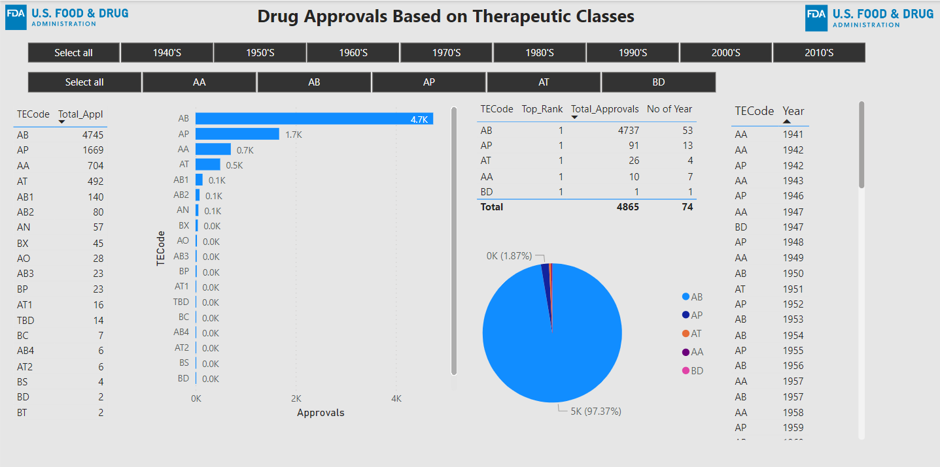
Part - 2 Power BI Visualizations:
Visualize drug approvals based on therapeutic classes. Identify classes with the highest number of approvals.
Therapeutic Class AB has the highest number of approvals over the years.
AB has ranked highest for 53 years out of the total 74 years from 1939 to 2016

Slide 18
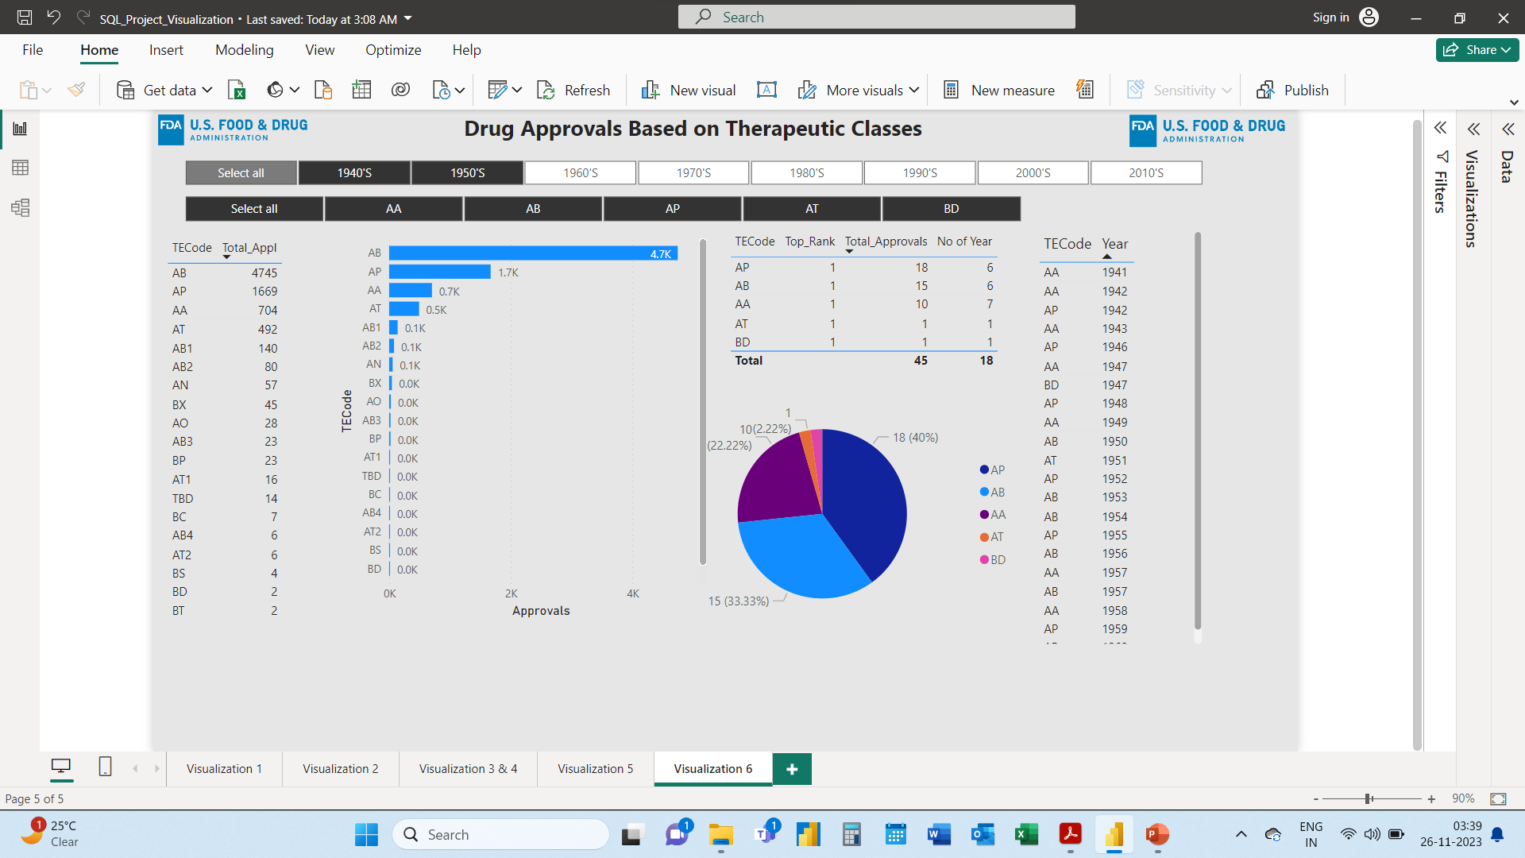
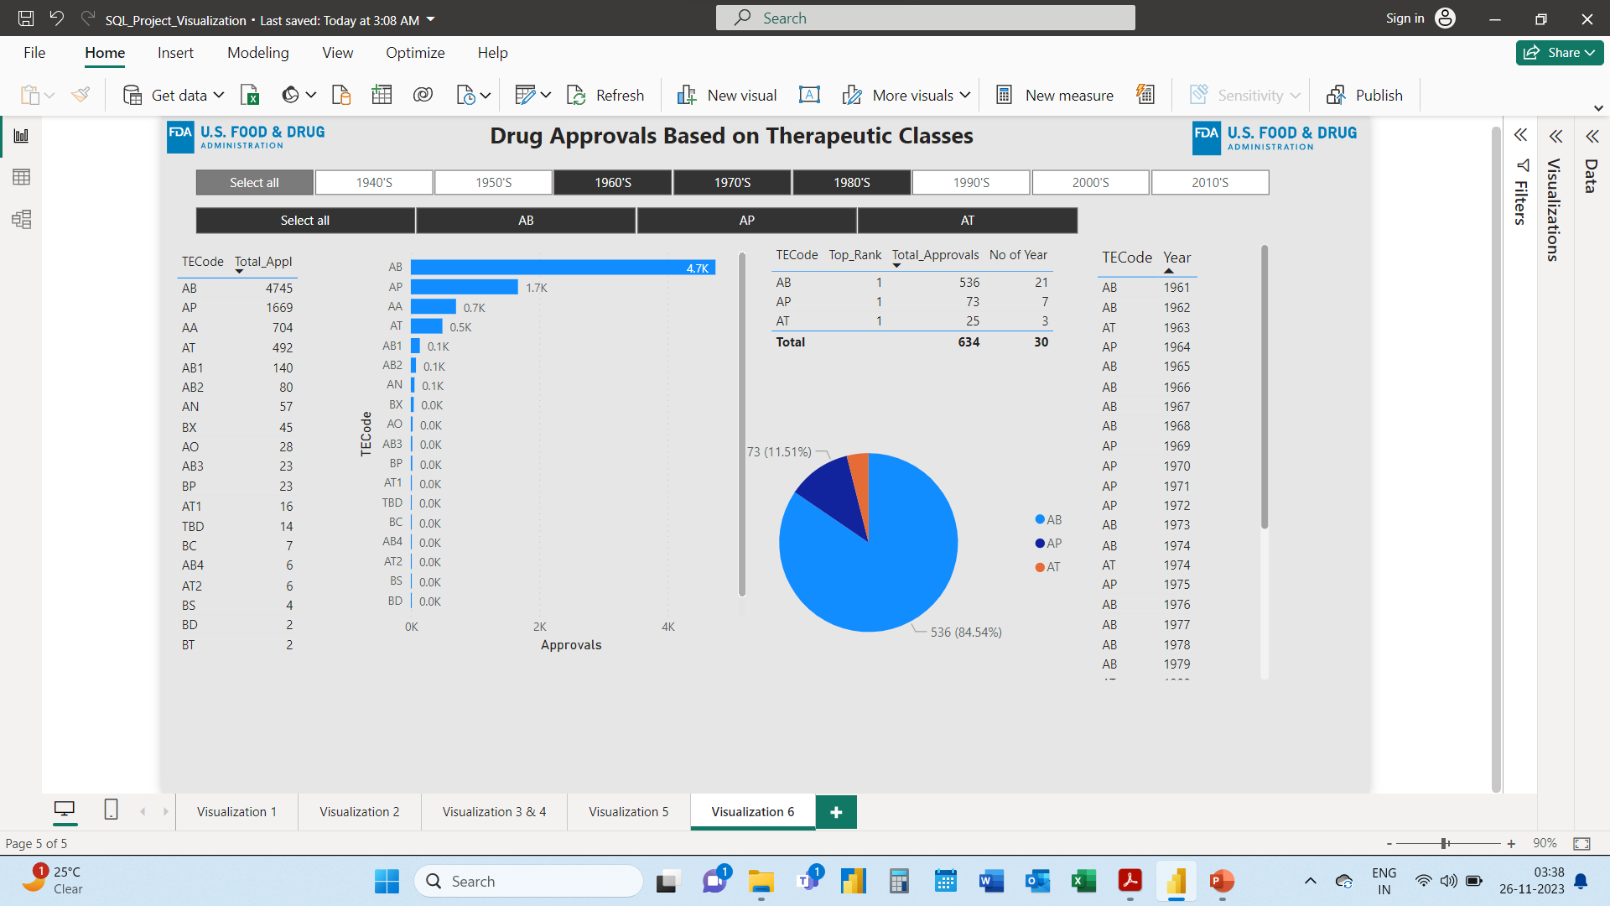
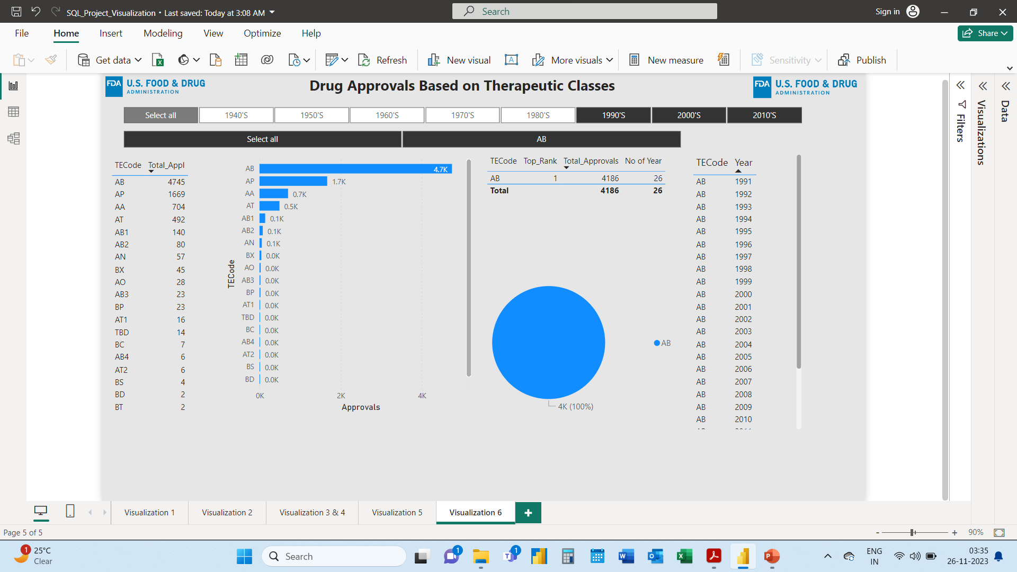
Therapeutic Class AP, AB, AA, AT & BD have ranked first in different years from 1930’s to 1959.
Therapeutic Class AP, AB & AT have ranked first in different years from 1960’s to 1980’s
Therapeutic Class AB have ranked first in different years from 1990’s to 2010’s

Slide 19
Project Objectives
Part - 1 SQL Queries

Slide 20
Task 1: Identifying Approval Trends
Determine the number of drugs approved each year and provide insights into the yearly trends.
Identify the top three years that got the highest and lowest approvals, in descending and ascending order, respectively.
Explore approval trends over the years based on sponsors.
Rank sponsors based on the total number of approvals they received each year between 1939 and 1960.

Slide 21
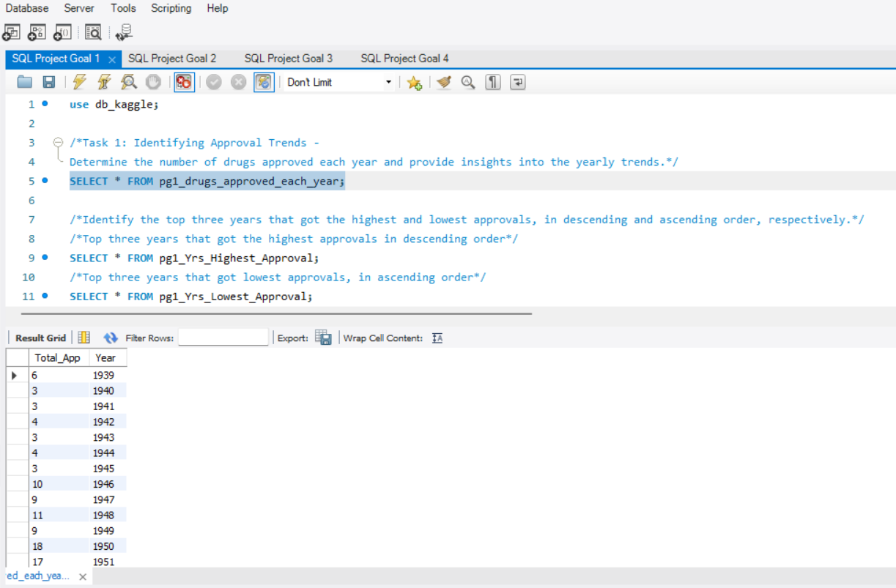
Task 1: Identifying Approval Trends
Determine the number of drugs approved each year and provide insights into the yearly trends.

Slide 22
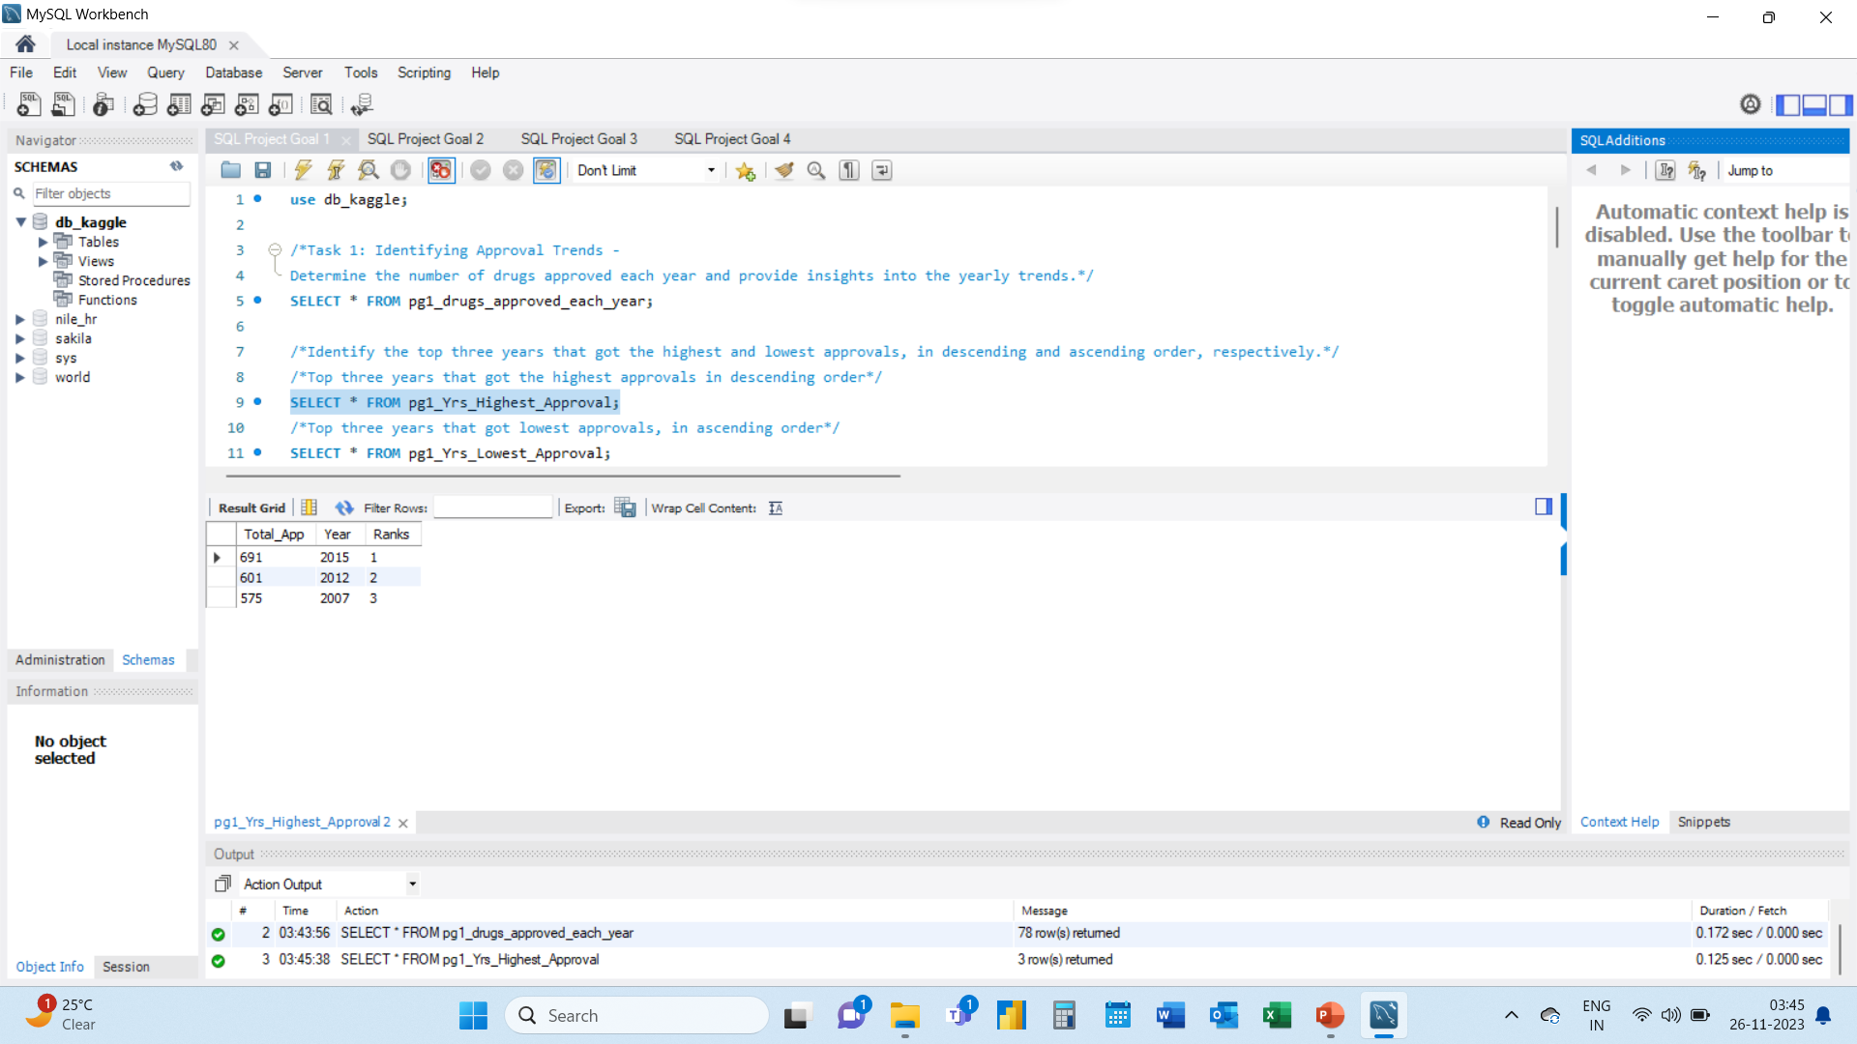
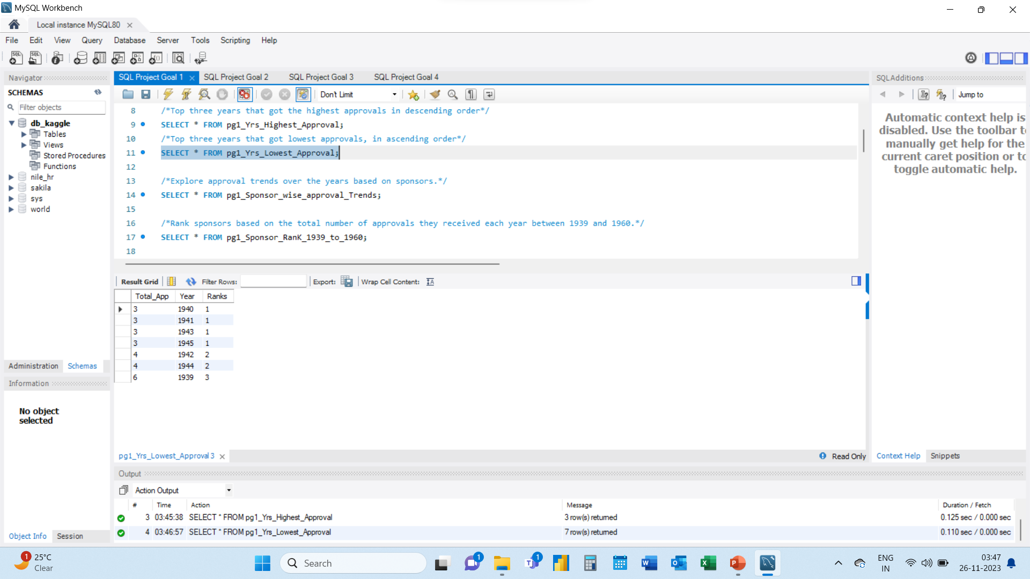
Task 1: Identifying Approval Trends
Identify the top three years that got the highest and lowest approvals, in descending and ascending order, respectively.

Slide 23
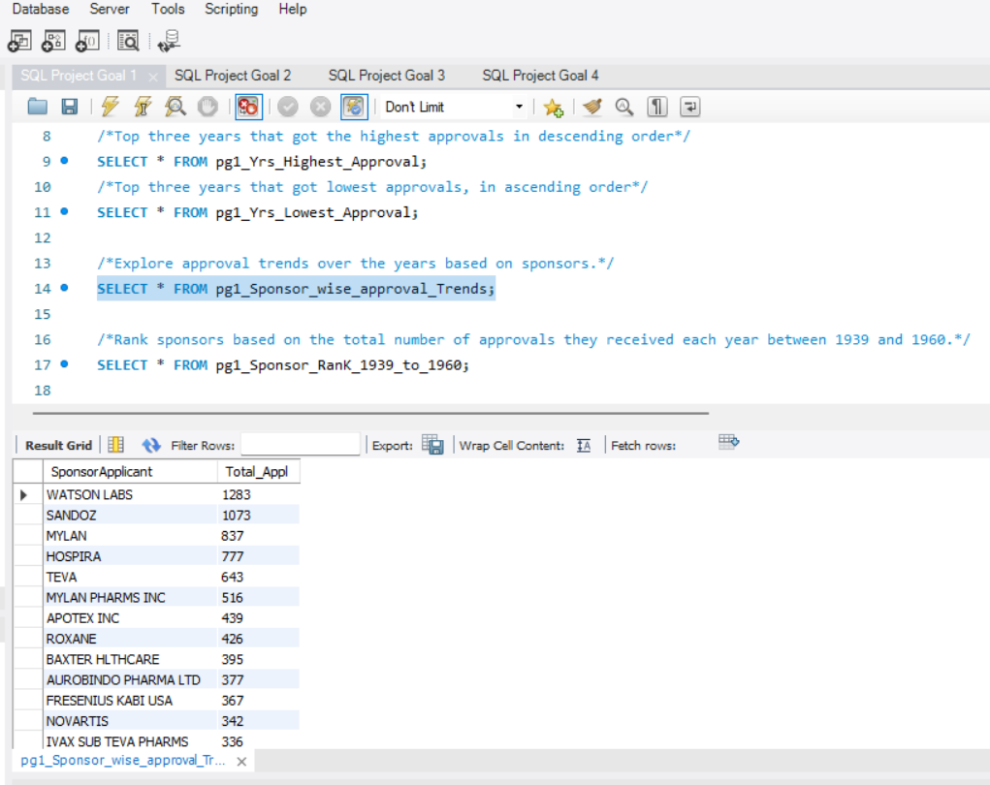
Task 1: Identifying Approval Trends
Explore approval trends over the years based on sponsors.

Slide 24
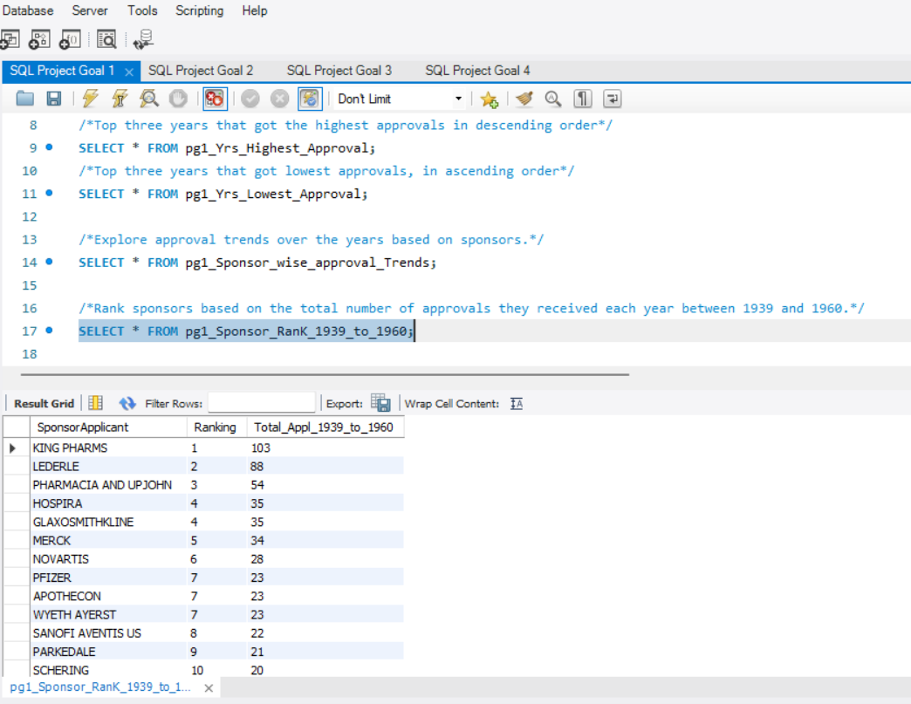
Task 1: Identifying Approval Trends
Rank sponsors based on the total number of approvals they received each year between 1939 and 1960.

Slide 25
Project Objectives
Part - 1 SQL Queries:
Task 2: Segmentation Analysis Based on Drug Marketing Status.
Group products based on Marketing Status. Provide meaningful insights into the segmentation patterns.
Calculate the total number of applications for each Marketing Status year-wise after the year 2010.
Identify the top Marketing Status with the maximum number of applications and analyze its trend over time.

Slide 26
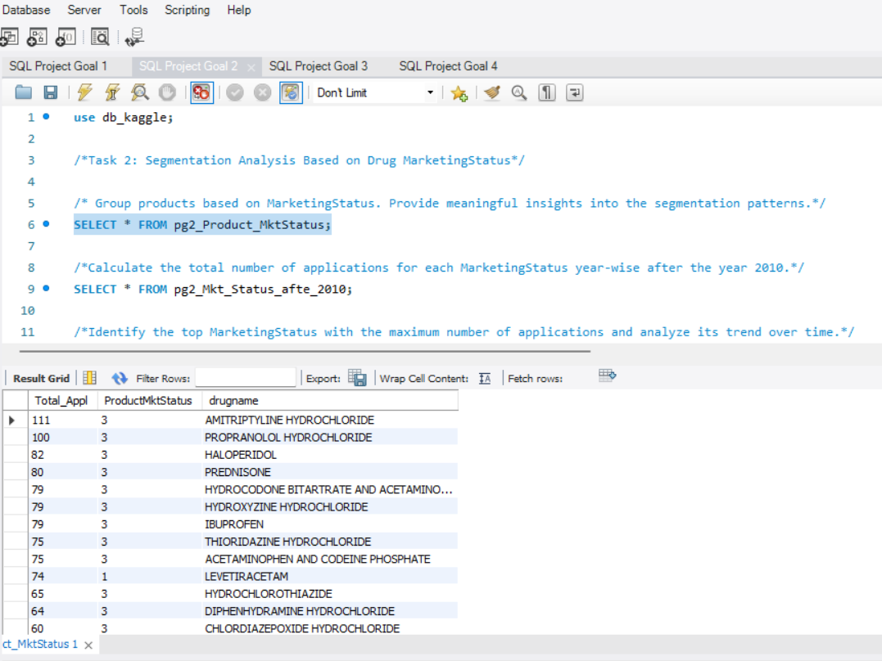
Task 2: Segmentation Analysis Based on Drug Marketing Status.
Group products based on Marketing Status. Provide meaningful insights into the segmentation patterns.

Slide 27
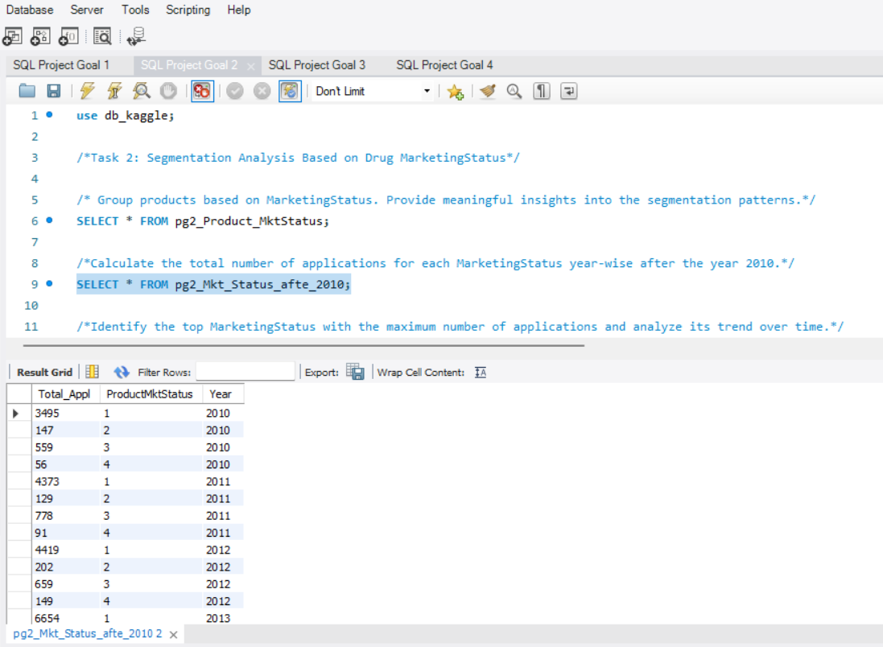
Task 2: Segmentation Analysis Based on Drug Marketing Status.
Calculate the total number of applications for each Marketing Status year-wise after the year 2010.

Slide 28
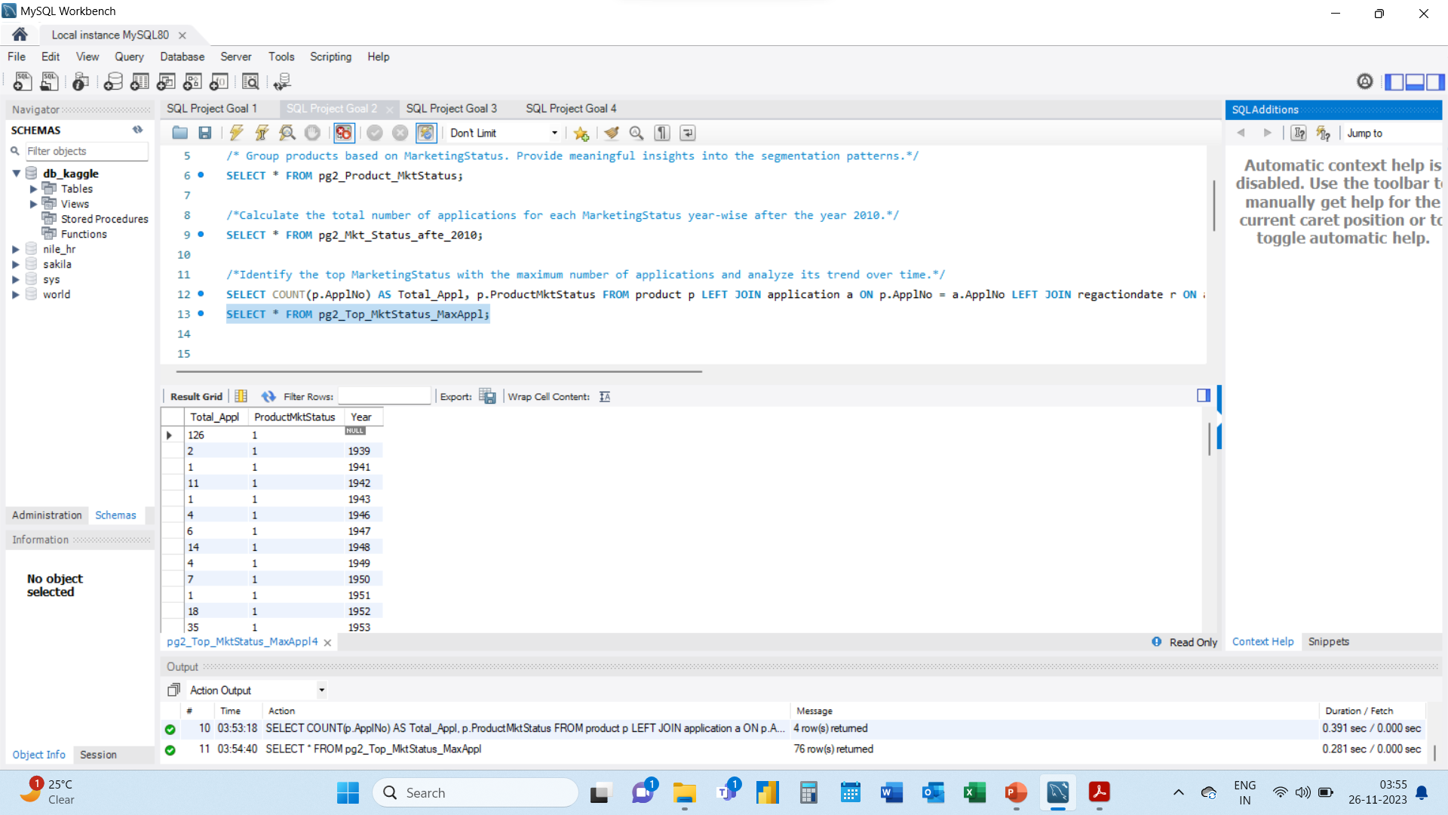
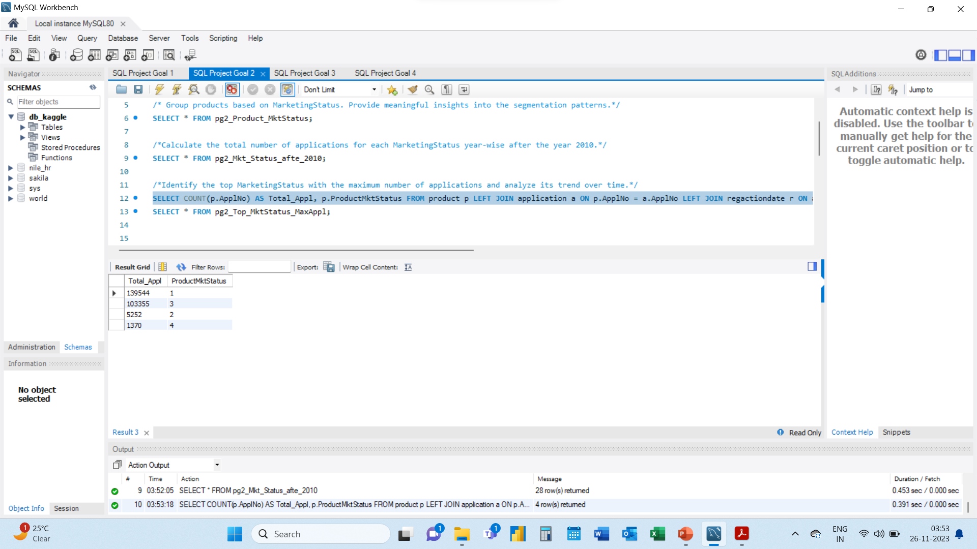
Task 2: Segmentation Analysis Based on Drug Marketing Status.
Identify the top Marketing Status with the maximum number of applications and analyze its trend over time.

Slide 29
Project Objectives
Part - 1 SQL Queries:
Task 3: Analyzing Products
Categorize Products by dosage form and analyze their distribution.
Calculate the total number of approvals for each dosage form and identify the most successful forms.
Investigate yearly trends related to successful forms.

Slide 30
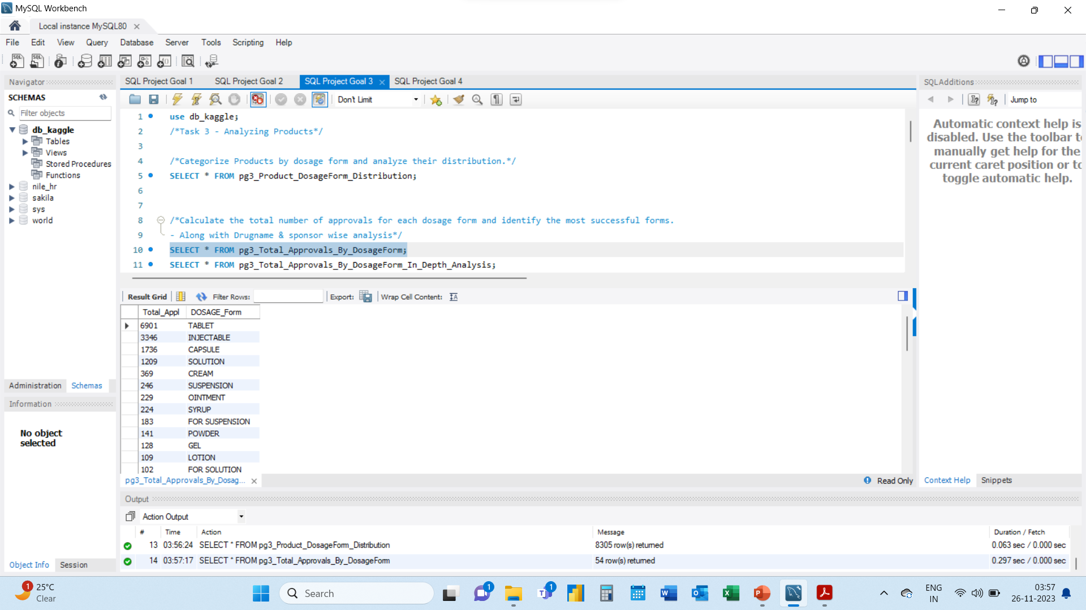
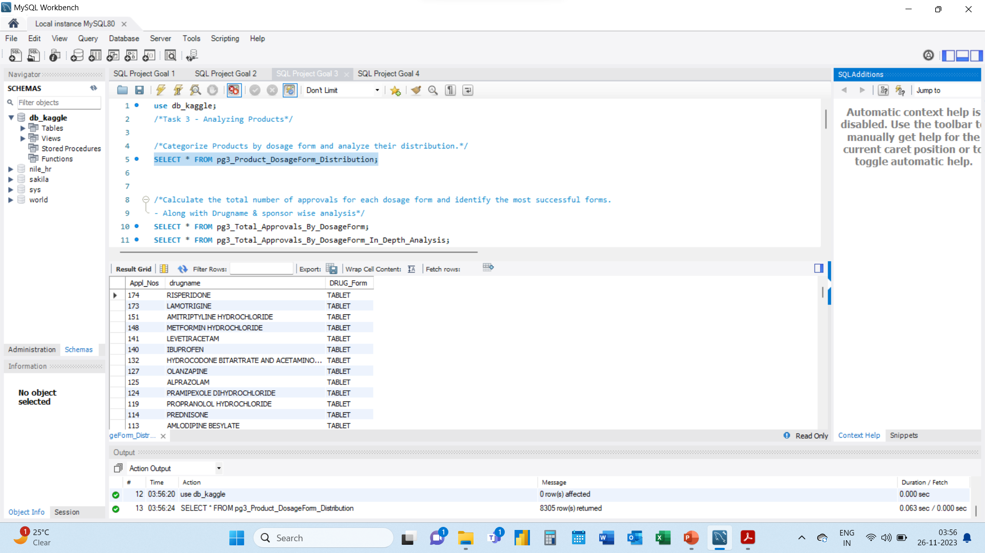
Task 3: Analyzing Products
Categorize Products by dosage form and analyze their distribution.

Slide 31
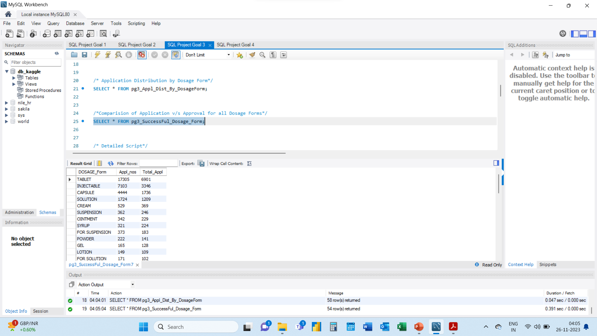
Task 3: Analyzing Products
Calculate the total number of approvals for each dosage form and identify the most successful forms.

Slide 32
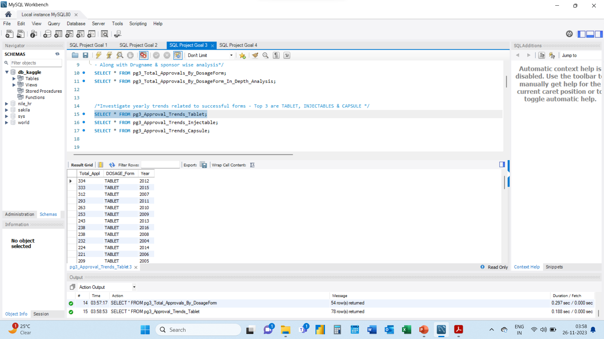
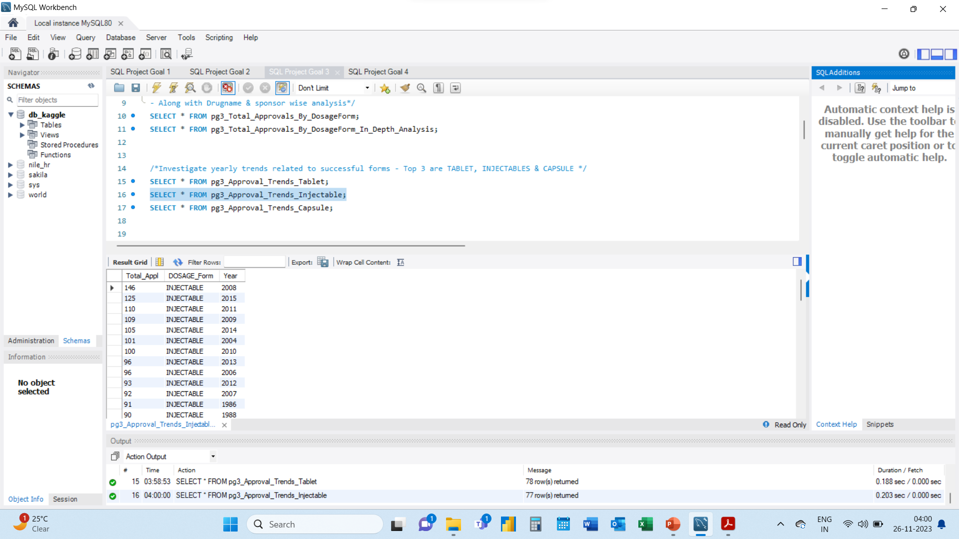
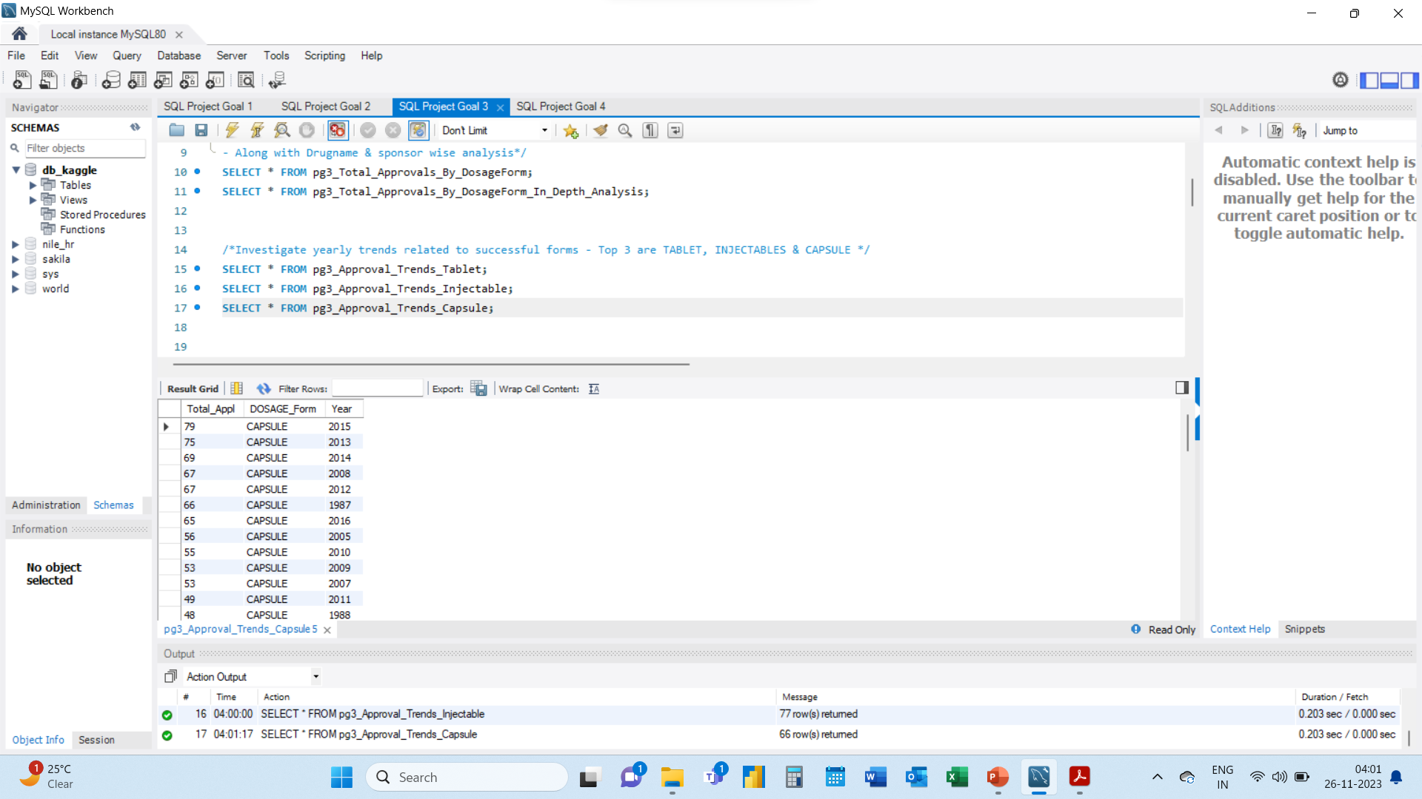
Task 3: Analyzing Products
Investigate yearly trends related to successful forms.

Slide 33
Project Objectives
Part - 1 SQL Queries:
Task 4: Exploring Therapeutic Classes and Approval Trends
Analyse drug approvals based on therapeutic evaluation code (TE_Code).
Determine the therapeutic evaluation code (TE_Code) with the highest number of Approvals in each year.

Slide 34
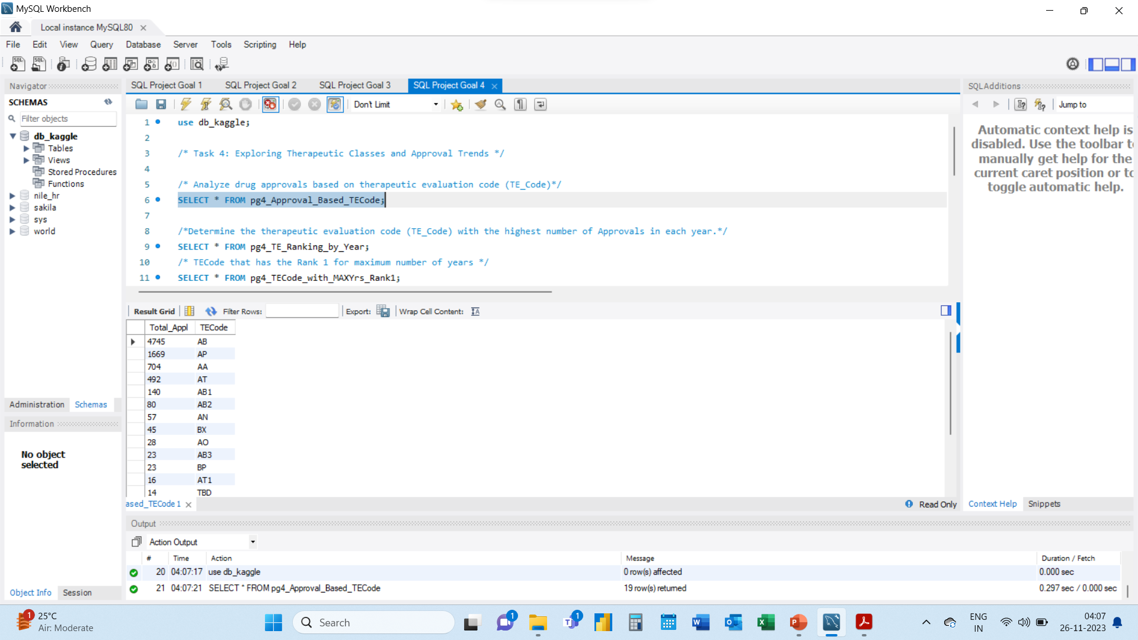
Task 4: Exploring Therapeutic Classes and Approval Trends
Analyse drug approvals based on therapeutic evaluation code (TE_Code).

Slide 35
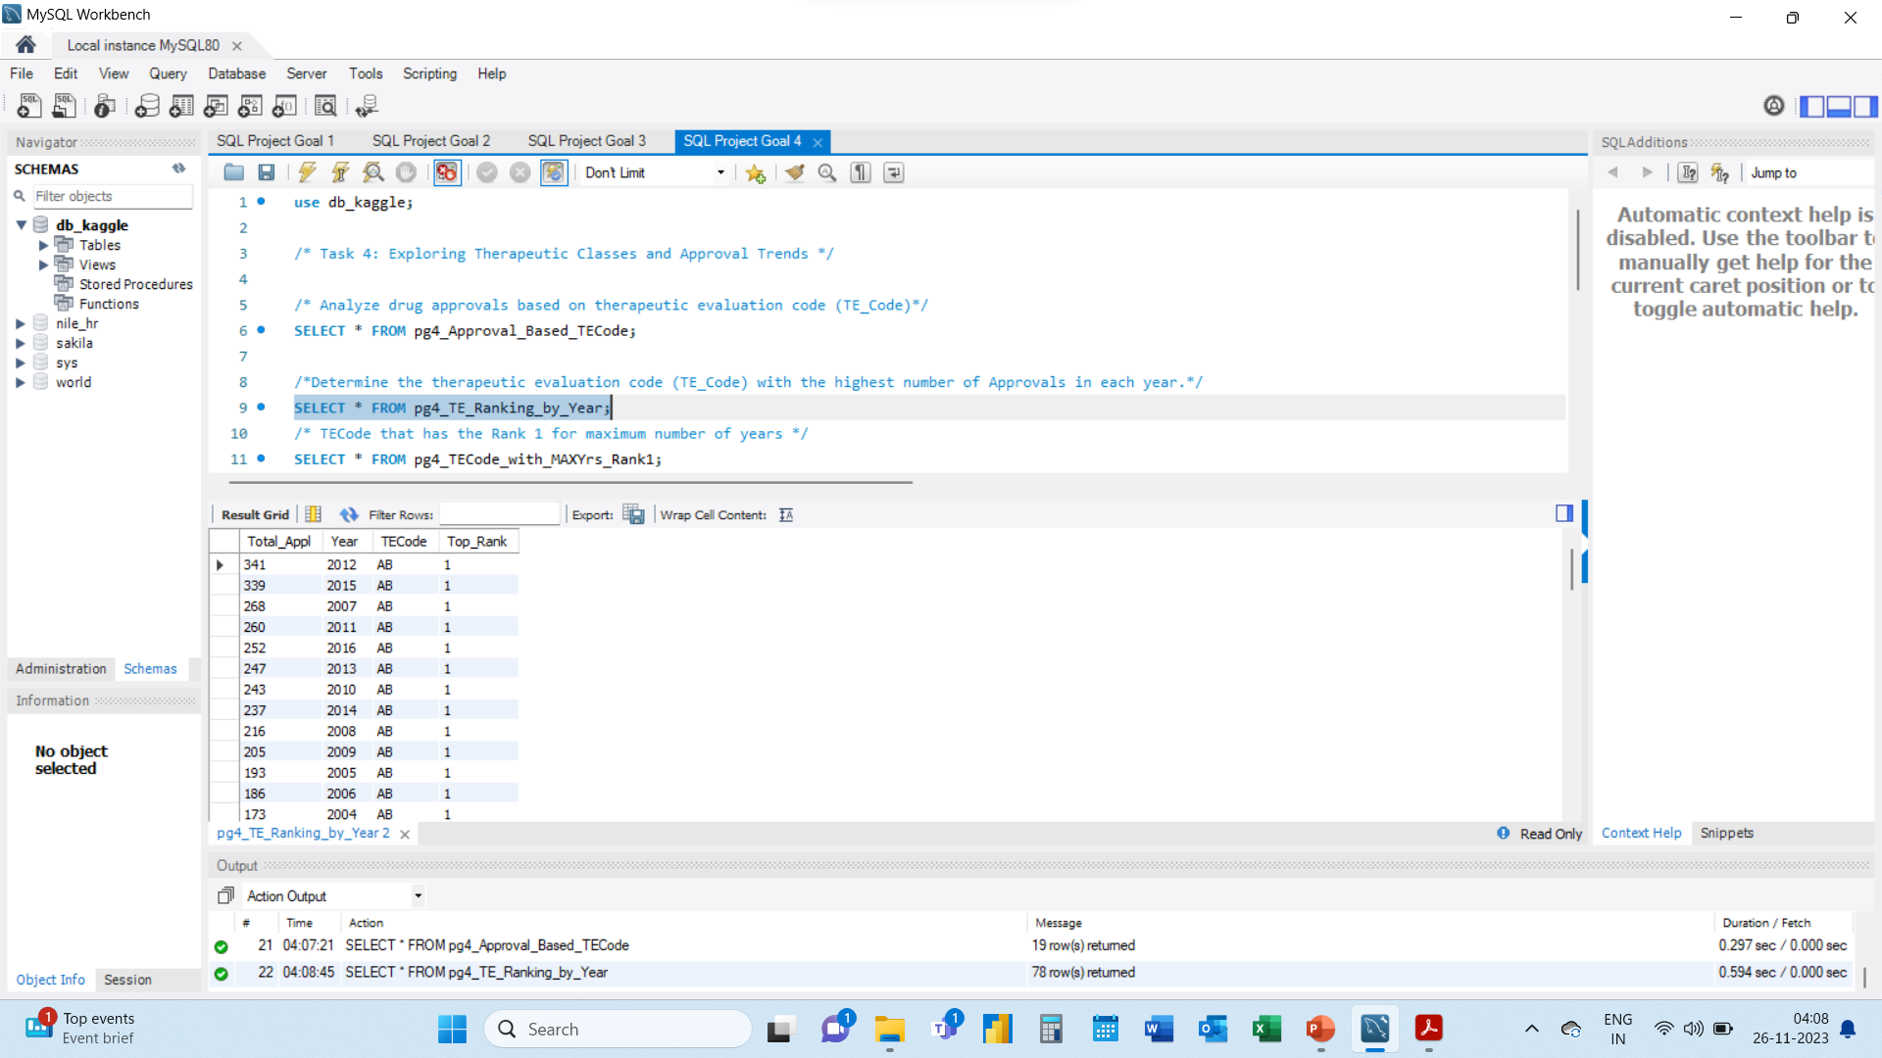
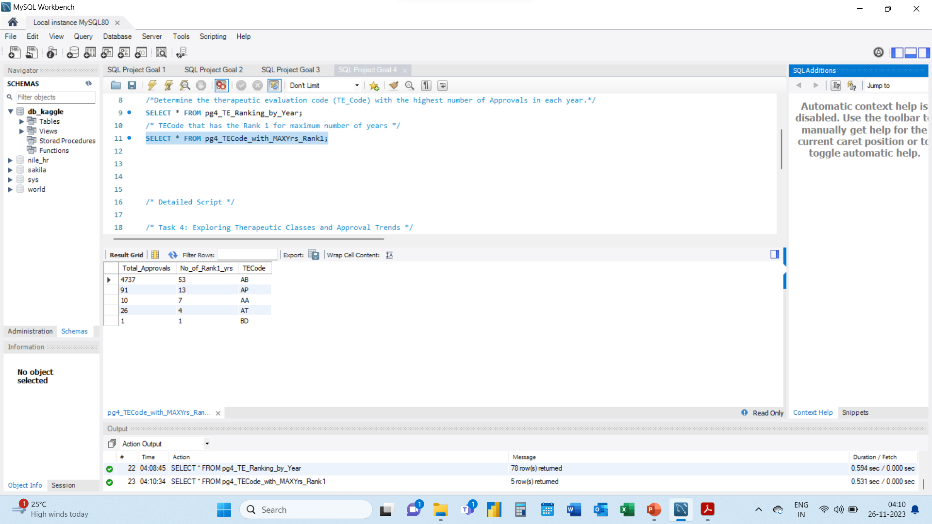
Task 4: Exploring Therapeutic Classes and Approval Trends
Determine the therapeutic evaluation code (TE_Code) with the highest number of Approvals in each year.

Slide 36
This is the end of the presentation.
THANK YOU
For Your Time and Attention

